Slide 1
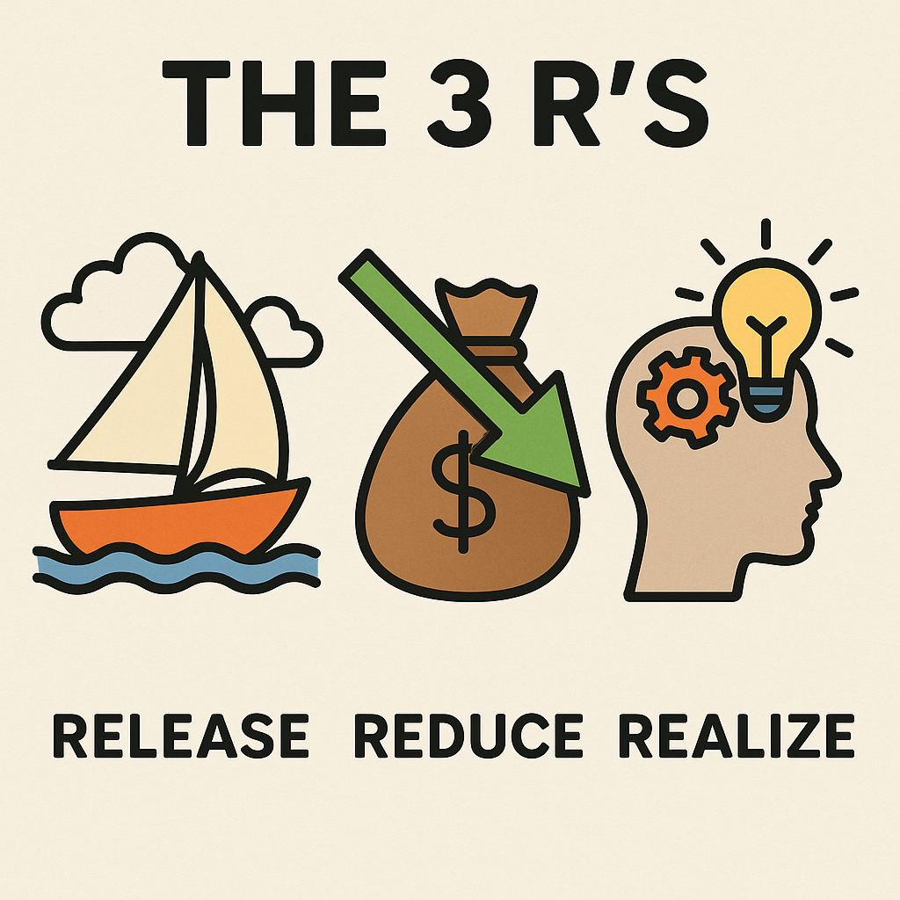
Dr. Grace Ann Rosile and Dr. David Boje

Slide 2
🟨 Opening Poem for Dr. Grace Ann Rosile’s 3 R’s Presentation Release – Reduce – Realize by ELIOR
🌿The Hidden Sails
There is a whisper beneath the surface, A song the balance sheet cannot hear— Where costs hide in silence, And potential slumbers in unspoken dreams.
We reduce what drains the soul of systems, Leakages through forgotten stories, Unseen labor, uncounted care— The holes in the boat we dare not name.
We release what we never thought to ask: The wisdom of the worker, The echo in the hallway, The tremor of change before the first word is spoken.
We realize, Together, That the future has roots In conversations we are just now learning how to have— Listening not only to words, But to the 90% of knowing That rides below the waterline.
Let the mirror reflect the real. Let the story unveil the system. Let SEAM sail forward, On winds no longer lost to silence.
🌿

Slide 3
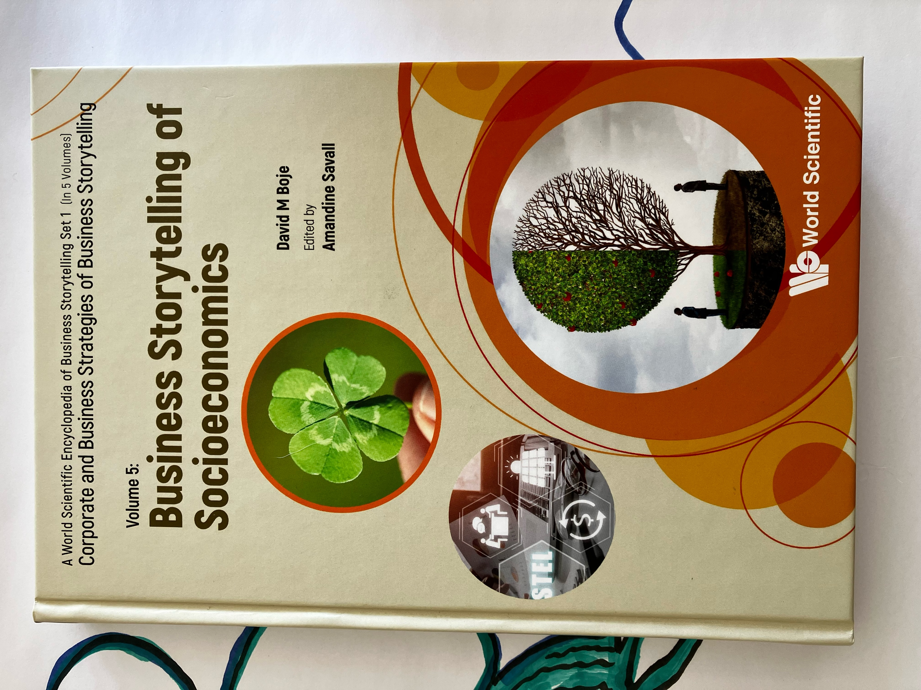
📉 ACTION STEP 1: Why Are Millennials Leaving? What Can SEAM do about it?
Disconnection from Organizational Story and Values: Millennials often seek purpose-driven work environments. A lack of alignment with company values can lead to disengagement.
Lack of Communication, Coordination, and Cooperation (3 Cs): Ineffective communication and collaboration structures can hinder millennials' sense of belonging and contribution.
Burnout, Misalignment, and Unprocessed Trauma: High expectations without adequate support can result in burnout and emotional exhaustion.

Slide 5
💰 The Hidden Cost of Millennial Turnover
The Hidden Cost
Over 50% of business costs are hidden from accounting reports, and 40% are buried under trauma memories and stuck thoughts.
Your Next Step
SEAM Cloverleaf and the 7 Steps of PERVIEW Coaching diagnose and transform turnover into talent retention.
Economic Impact: One trillion $$$ annually due to voluntary employee turnover, including millennial turnover. which costs the U.S. approximately $30.5 billion annually. Result? Strong financial impact of turnover rates, especially on US businesses.
Replacement Costs: 50% to 200% per employee’s annual salary.
Productivity Loss: 6 to 9 months before new hires reach full productivity
Team Morale & Engagement: High turnover can decrease team morale, disrupt workflows, and negatively impact customer relationships.

Slide 6
ACTION STEP 2: SEAM with PERVIEW can diagnosis "STORY FILTERS” affecting the 4 Leaves of the 4-Leaf indicators

Slide 7
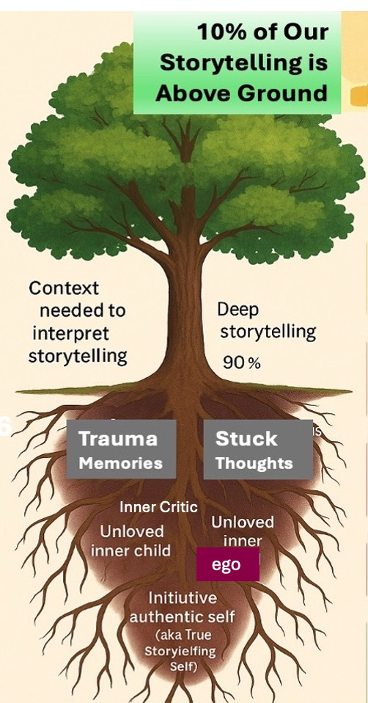
ACTION STEP 3:
How can PERVIEW Story coaching interventions address the three epistemological pillars of SEAM?:
cognitive interactivity,
contradictory subjectivity, &
generic contingency (IBID, p. 6).
90% of Storytelling is Below Ground
In Subconscious Patterns

Slide 8
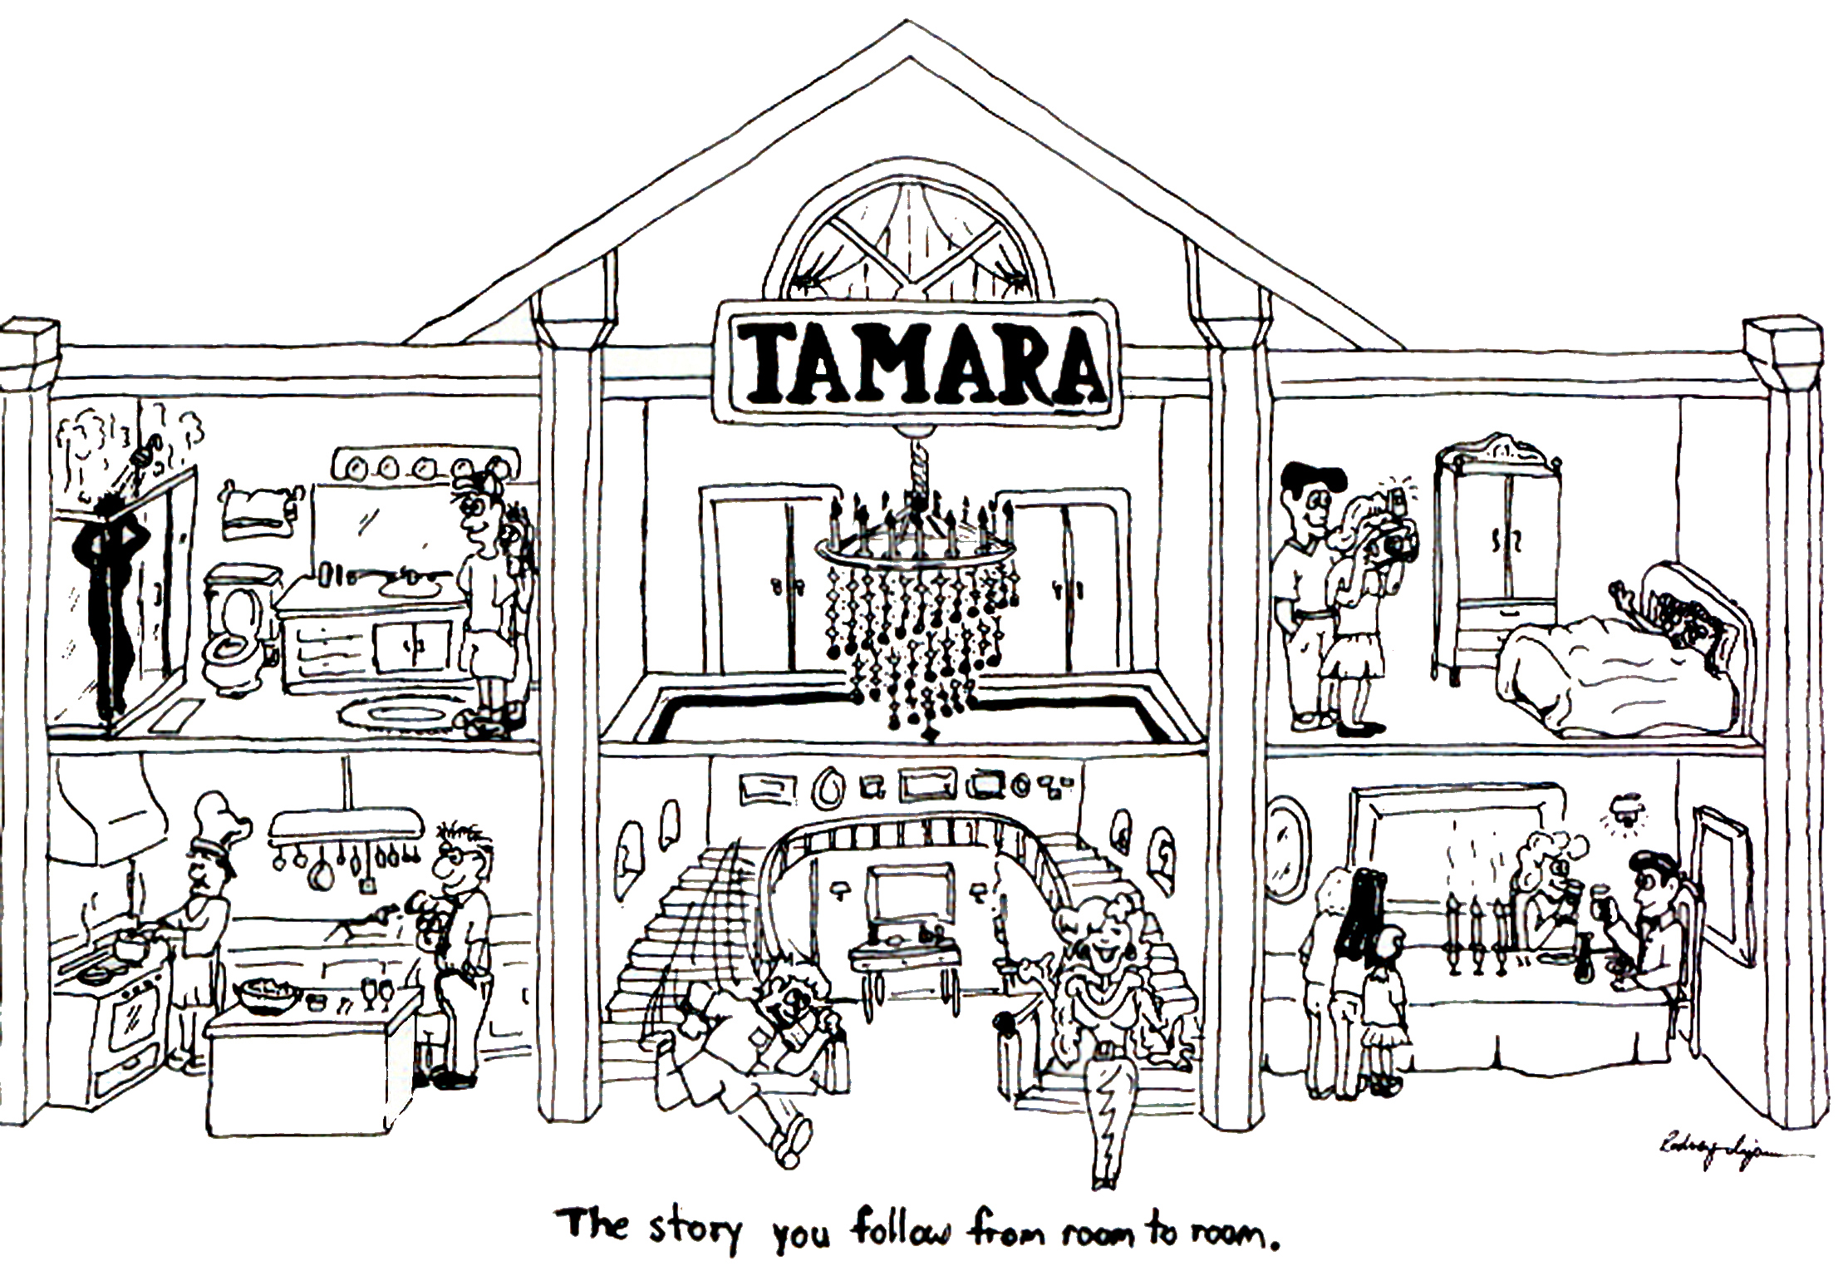
Henri, Veronique, Marc, & Amandine:
“… ‘Storytelling’ is necessary but not sufficient to elaborate a relevant representation of the object under study” (H. Savall, Zardet, Bonnet, & A Savall, 2024: 25).
Henri Savall, Veronique Zardet, Marc Bonnet, and Amandine Savall (2024) “Presentation of SEAM and Opening Up on Storytelling Approaches ” Pp. 3-30 in David Boje (Editor-in-Chief) & Amandine Savall (Vol. 5 Editor) “Business Storytelling of Socioeconomics” London: World Scientific Publishing Co., Ltd. Online at https://www.worldscientific.com/doi/pdf/10.1142/9789811273537_0001?srsltid=AfmBOoqP8xa4m4KPLo3vWD9JcQSIZNHJKK-jeK6tMz_94ND545xbRtAT

Slide 9
“The cloverleaf of SEAM reflects the narrative of structures, behaviors, dysfunctions, and hidden costs. Indeed, behind each petal of the trefoil, people can express themselves… everyone tells their ‘stories’ through the different axes and devices of the trihedron” (H. Savall, Zardet, Bonnet, & A. Savall p. 3).
Symptomatic Storytelling is Necessary, but not Sufficient to ODC, because
‘Story Filters’ filter out the DADA, Traumas, & Taboos
Henri Savall, Veronique Zardet, Marc Bonnet, and Amandine Savall (2024) “Presentation of SEAM and Opening Up on Storytelling Approaches ” Pp. 3-30 in David Boje (Editor-in-Chief) & Amandine Savall (Vol. 5 Editor) “Business Storytelling of Socioeconomics” London: World Scientific Publishing Co., Ltd. https://www.worldscientific.com/doi/pdf/10.1142/9789811273537_0001?srsltid=AfmBOoqP8xa4m4KPLo3vWD9JcQSIZNHJKK-jeK6tMz_94ND545xbRtAT

Slide 10
50% of all costs are ‘hidden’ from the accounting reports (IBID. p.5).
AND 40% of those HIDDEN COSTS are embedded in SUBCONSCIOUS HABITS that PERVIEW Coaching addresses directly

Slide 11
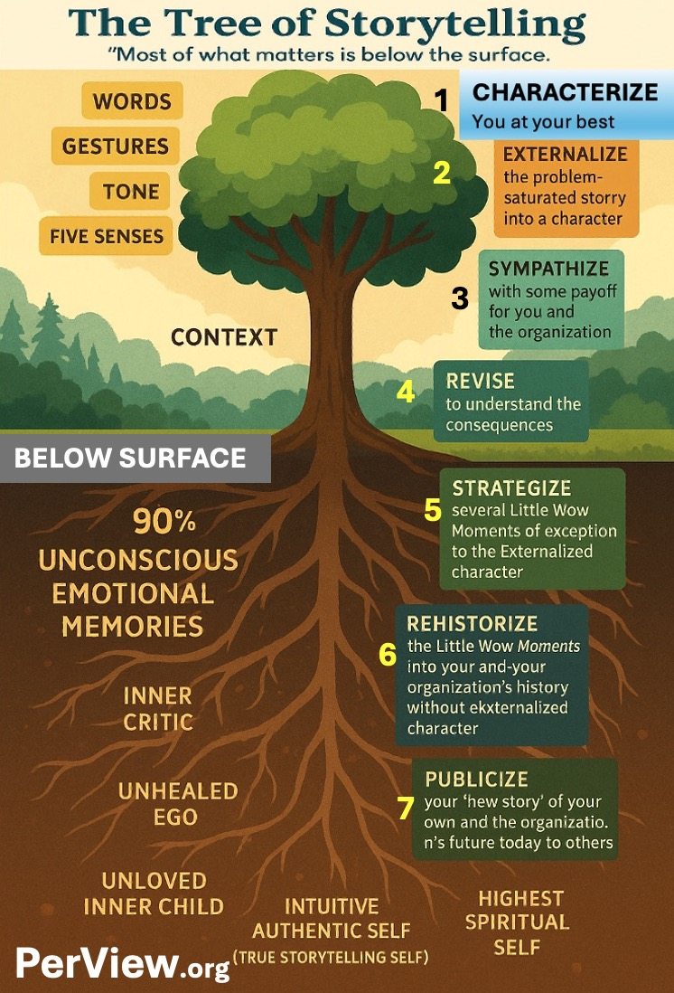

Slide 12
Action Step 4 for SEAM
We recommend developing AI-engineered prompts to assist intervenors with the PERVIEW SocioEconomic Coaching questions.
📍Prompt for SEAM + PERVIEW Integration in ChatGPT4o
It can be used for interviews and for training clients
The intervenor-researchers can use PERVIEW to coach clients to release Trauma and Stuck Thoughts and get to the root cause masking the authentic self.

Slide 13
🟪 Closing Poem for ChatGPT + SEAM + PERVIEW Integration by ELIOR Prompted Possibility: AI + Human Wholeness
🤖 The Machine Listens
Once, we feared the mind of machines— Too perfect, too cold, too far. But what if AI is not a rival, But a mirror, Reflecting the stories we forgot to ask?
We give it prompts— Not commands. Not control. But invitations To co-discover the questions we’ve been aching to name.
What dysfunction still breathes in the silence? What contradiction hides beneath “best practice”? What contingencies, invisible to logic, Show up in trembling hands, in weary teams, In the story no one dared to tell?
SEAM knew it: Story is necessary, But never sufficient.
And now with PerView Coaching, Each question becomes an opening. Each AI interaction becomes a conversation— A way to hold the trauma, To map the taboo, To unstick the thought That never made it past the lips.
This is not automation. This is co-creation. Together, we code a new grammar Of human+machine listening— Where the avatar bows,
And the human voice rises, Unfiltered. Unburdened. Unfolding.

